Slide 1
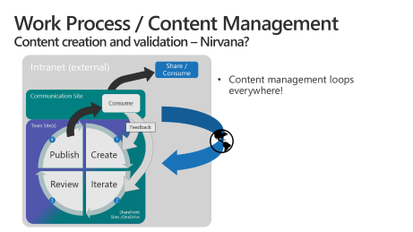
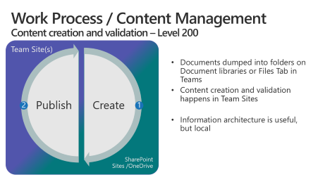
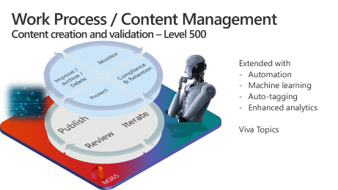
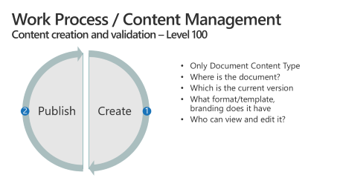
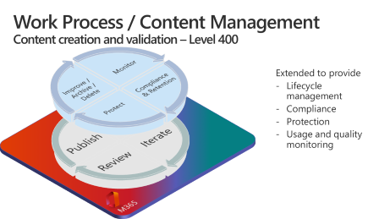
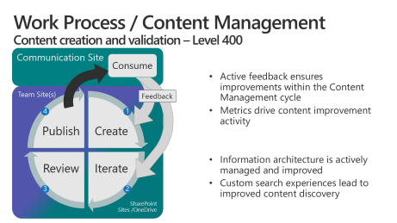
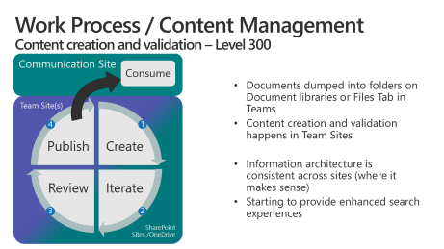
Overview

Slide 2
Work Process / Content Management Content creation and validation – Level 100
Create
Publish
Only Document Content Type
Where is the document?
Which is the current version
What format/template, branding does it have
Who can view and edit it?
2
1
Notes:
This content management cycle applies to almost anything we create, even in our personal lives. Consider working on a homework assignment in grade school. The same cycle holds.
Every Content Type has a different mix of these four activities and different levels of complexity driven by the business value or regulatory requirements for the content.

Slide 3
Work Process / Content Management Content creation and validation – Level 200
Team Site(s)
Create
Publish
Documents dumped into folders on Document libraries or Files Tab in Teams
Content creation and validation happens in Team Sites
Information architecture is useful, but local
2
1
SharePoint Sites /OneDrive
Notes:
This content management cycle applies to almost anything we create, even in our personal lives. Consider working on a homework assignment in grade school. The same cycle holds.
Every Content Type has a different mix of these four activities and different levels of complexity driven by the business value or regulatory requirements for the content.

Slide 4
Work Process / Content Management Content creation and validation – Level 300
Communication Site
Consume
Documents dumped into folders on Document libraries or Files Tab in Teams
Content creation and validation happens in Team Sites
Information architecture is consistent across sites (where it makes sense)
Starting to provide enhanced search experiences
Team Site(s)
Create
Iterate
Review
Publish
4
1
3
2
SharePoint Sites /OneDrive
Notes:
This content management cycle applies to almost anything we create, even in our personal lives. Consider working on a homework assignment in grade school. The same cycle holds.
Every Content Type has a different mix of these four activities and different levels of complexity driven by the business value or regulatory requirements for the content.

Slide 5
Work Process / Content Management Content creation and validation – Level 400
Communication Site
Consume
Active feedback ensures improvements within the Content Management cycle
Metrics drive content improvement activity
Information architecture is actively managed and improved
Custom search experiences lead to improved content discovery
Team Site(s)
Create
Iterate
Review
Publish
Feedback
4
1
3
2
SharePoint Sites /OneDrive
Notes:
This content management cycle applies to almost anything we create, even in our personal lives. Consider working on a homework assignment in grade school. The same cycle holds.
Every Content Type has a different mix of these four activities and different levels of complexity driven by the business value or regulatory requirements for the content.

Slide 6

Work Process / Content Management Content creation and validation – Level 400
Monitor
Compliance & Retention
Protect
Improve / Archive / Delete
M365
Create
Iterate
Review
Publish
Extended to provide
Lifecycle management
Compliance
Protection
Usage and quality monitoring
4
1
3
2
Notes:
This content management cycle applies to almost anything we create, even in our personal lives. Consider working on a homework assignment in grade school. The same cycle holds.
Every Content Type has a different mix of these four activities and different levels of complexity driven by the business value or regulatory requirements for the content.

Slide 7


Work Process / Content Management Content creation and validation – Level 500
Monitor
Compliance & Retention
Protect
Improve / Archive / Delete
M365
Create
Iterate
Review
Publish
Extended with
Automation
Machine learning
Auto-tagging
Enhanced analytics
Viva Topics
4
1
3
2
Notes:
This content management cycle applies to almost anything we create, even in our personal lives. Consider working on a homework assignment in grade school. The same cycle holds.
Every Content Type has a different mix of these four activities and different levels of complexity driven by the business value or regulatory requirements for the content.

Slide 8

Work Process / Content Management Content creation and validation – Nirvana?
Intranet (external)
Share / Consume
Content management loops everywhere!
Communication Site
Consume
Team Site(s)
Create
Iterate
Review
Publish
Feedback
4
1
3
2
SharePoint Sites /OneDrive

